Slide 1
Mungo Man’s return
17th November 2017

Slide 2
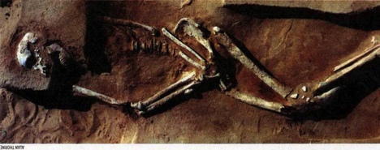
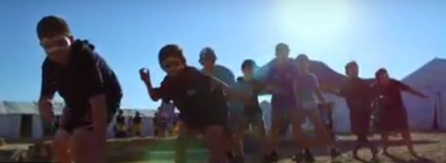
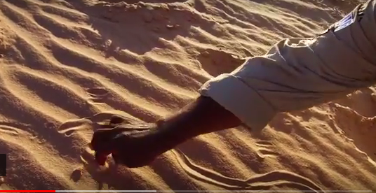
By his death and reappearance, Mungo Man has revealed to us that deep spirit connection his people had with the earth. It is one repeated today with his Aboriginal descendants in their "Connection to Country".

Slide 3
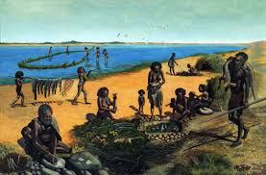
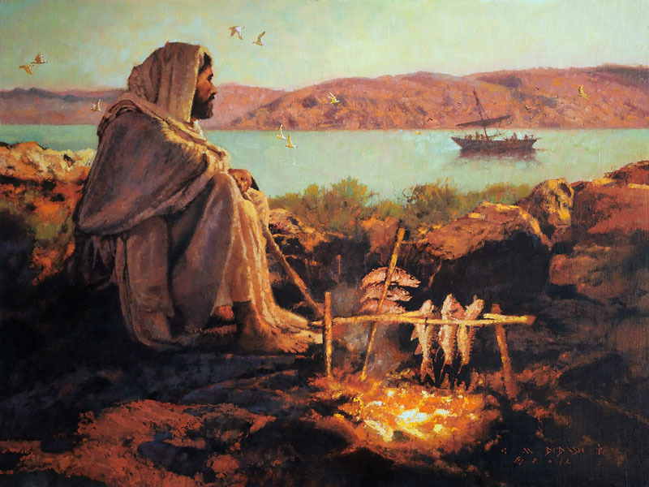
The nature and occasion of those two deaths were very significant, although separated by time and place; those events on the shores of Lake Mungo resonate with those in Jerusalem.
both reflect that deep spirit connection between the divine and the earth, our Mother

Slide 4
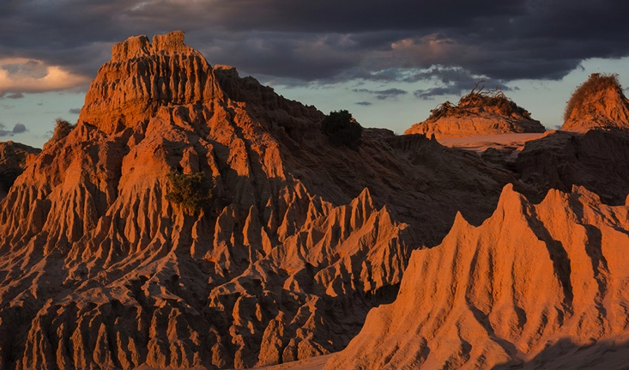
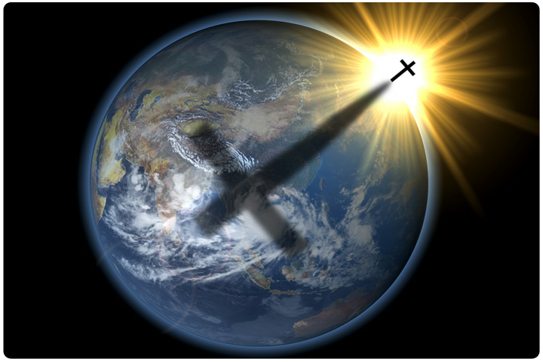
The earth from which we came, takes on its special spirit significance. In union with Mungo Man we can say the world around us, from stars in the heavens to the rocks and plants on earth, all share in the sacred relationship with the divine

Slide 5
…the sacred relationship with the divine… speaks to us today in the re-emergence from the death and burial of that man on Lake Mungo shores 40,000 years earlier.

